Slide 1
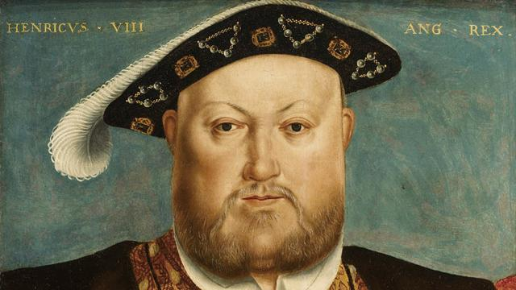
RABAT
THE TIMES
📰
Thursday, May 16, 2019
HISTORY SCIENCE
Jousting killed Henry VIII ?
King Henry VIII (1491-1547) ruled England for 36 years.
During 15 years, while Henry fought over three wars with France, his wife Katherine of Aragon gave birth to three sons and three daughters.
How did the Sporty & Charming
Prince turn into a Cruel, an Obese, a Tyrant king?
Born on June 28, 1491, he is the second son of Henry VII
Henry VIII took the throne at the age of 17 and he then married Katherine of Aragon six weeks later. It was reported that when he was crowned in 1509, he was tall, robust, handsome and athletic. 38 years later, when he died, he weighed about 178 kg and had a waist measurement of 52 Inches and a chest measurement of about 53 inches.
Unfortunately, there were miscarriages and
babies died a few days after their births,
only Mary survived and later on she became
Queen Mary I.
Notes:
1

Slide 2
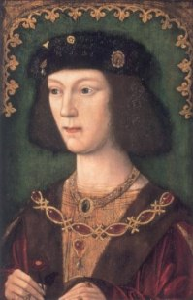
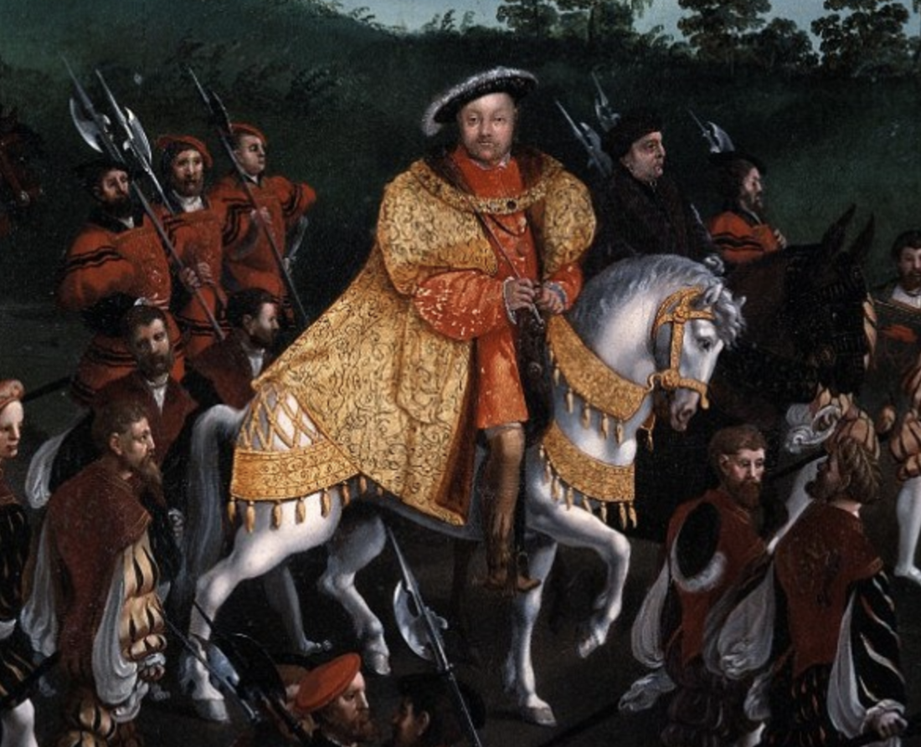
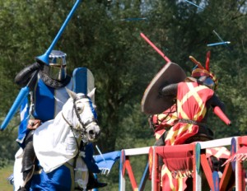
RABAT
THE TIMES
📰
Thursday, May 16th, 2019
An athletic, handsome, exuberant and intelligent king
As a young king Henry was considered to be the most handsome prince in Europe.
He was tall, standing at six foot two which was taller than the average man of the time. He had broad shoulders and very developed legs and arms.
Henry was a sports enthusiast. he was always brimming with energy. he was constantly out doing activities and he hated being locked up at meetings or for paperwork.
Henry was into hunting. He also enjoyed a range of sports and hobbies, including tennis, wrestling, archery, masquerades, dancing and music. He was also extremely passionate about tilting and jousting.
Actually; it was reported That Henry VIII was the best jousters in England. Jousting is considered to be an extreme and dangerous sport because the jousters have to be excellent horsemen, It is very likely that an accident may happen, therefore, Henry VIII was challenging his body and fate.
Jousting

Slide 3
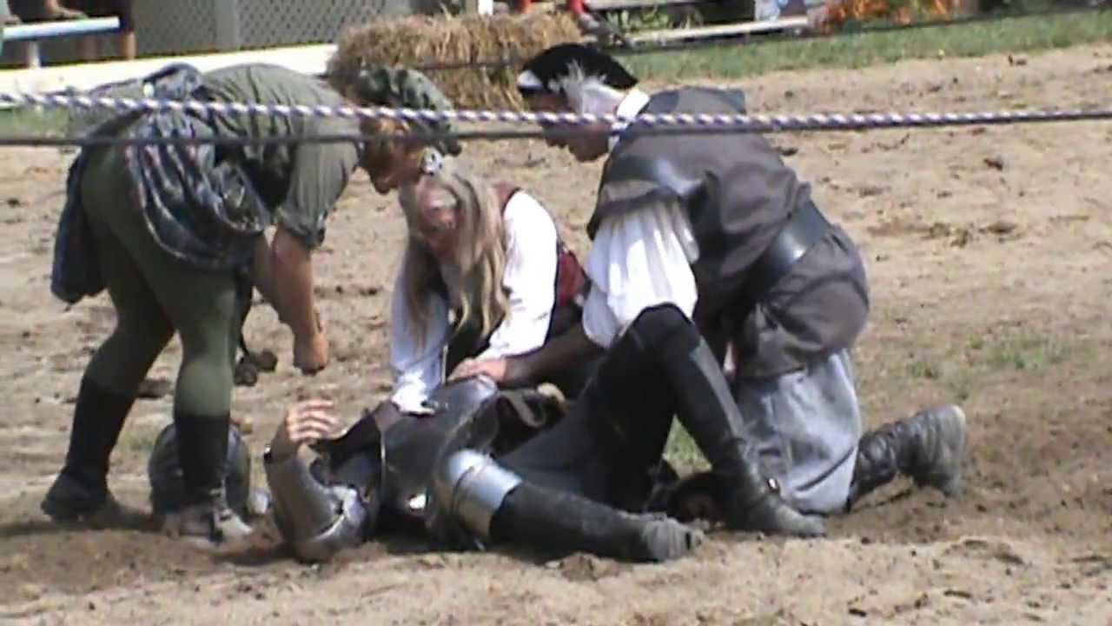
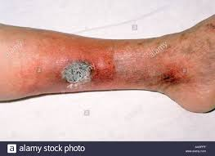
RABAT
THE TIMES
📰
Thursday, May 16, 2019
The jousting accident
While he was practicing jousting in 1536, Henry fell from his horse and was then unconscious for about two hours.
He was probably crushed by the weight of his armour and his horse.
It was said that he was already suffering from varicose ulcers (A venous ulcer, sometimes called a varicose ulcer, is a leg wound that happens when the leg veins don’t circulate blood back toward the heart. Blood can back up in the veins, building up pressure on the skin, which can cause an open sore to form)
So the pressure of the armour and the horse worsened the
ulcers in his legs. Due to this he was then unable to exercise.
And till the end of his life, Henry had to be carried in a chair as the pain in his leg was growing fast. He started to excessively eat and he was often constipated and suffered from terrible mood swings.

Slide 4
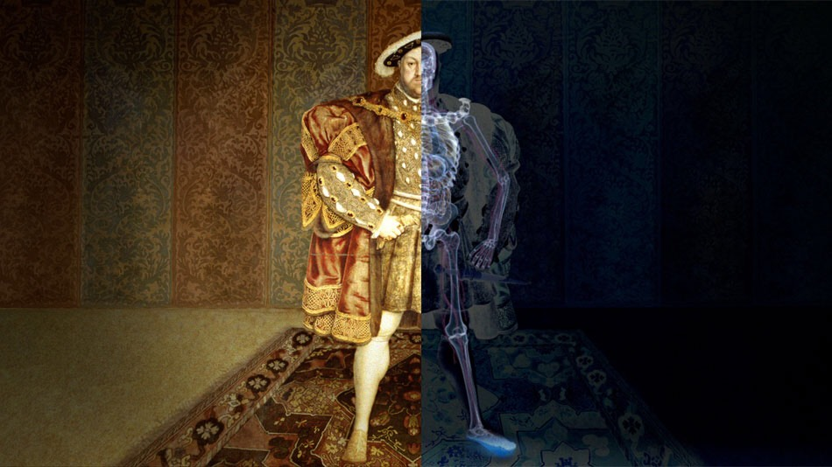
📰
RABAT
THE TIMES
Thursday, May 16th, 2019
Henry’s head injury is said to have had a severe impact on his mood swings because the part of the brain which controls the mood has been damaged. His frontal lobes were affected, the brains center for emotion and personality. Henry’s doctors are unable to treat his head trauma but try to heal his badly ulcerated legs. Although, after the incident, every time he seemed to get better his condition became worse.
He may also have developed bone infections that fester underneath the ulcers this explains mainly why he fell ill every time he healed. From the years following the accident, Henry became a cruel despot so different from the gallant prince he once was. He executed every friend, ally or wife, whenever he doubted his loyalty or he considered him or her an obstacle, so the guilty was ruthlessly and mercilessly executed .
Some historians speculate that as many as 17 000 of his subjects died by his hands or through his laws. By now Henry is a long far cry from what he used to be.
By the end of his reign, it was recorded that he weighed nearly 400 pounds thus; he was England’s fattest monarch. We later also discovered that he was a diabetic. As a result, he had poor eyesight, terrible circulation and poor blood pressure. Type 2 diabetes is one disease Henry never managed to escape. The king so obsessed with his glorious and strong image, his last days were less majestic, dignified and kingly.

